Slide 1

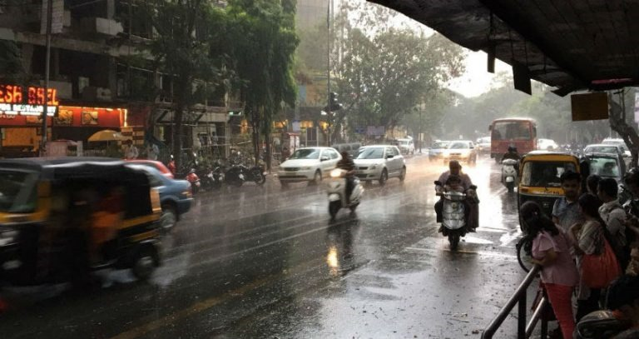
SCHOOL OF ENGINEERING AND SCIENCE
DEPARTMENT OF APPLIED SCIENCE AND HUMANITIES
S.Y M.Sc. (Applied Statistics – Data Science)
22MSDS321: Capstone Mini Project
Time Series and Machine learning Approach for Weather Forecasting
PRESENTED BY
Mr. Suraj Ramchandra Jagtap MITU22MSDS0012
Mr. Rohit Mahendra Dixit MITU22MSDS0028
Under the Guidance of
Dr. Ashok Kumar

Slide 2



Index
Introduction
Objectives
Review of Literature
Data Pre-processing
- Data Description
Exploratory Data Analysis
Time Series Model Random Forest Regressor Fitting and Forecasting
Comparison performance of Time Series models.
Conclusion

Slide 3
Introduction
Pune, located in state of Maharashtra, India. Pune is known for its dynamic and changeable environment. Pune has four different seasons like hot and dry summer, monsoon season with heavy rainfall, spring and a chilly winter.
Temperature during the summer frequently increase, resulting in burns and dry conditions. Summer season start from March to May. In summer months the temperature increases up to 38 degrees Celsius.
The monsoon season occurs from June to September. The monsoon produces heavy rain that change the weather. During the monsoon the monthly the average Rainfall of Pune is 61.8 mm per month. In monsoon months humidity levels rises and affecting the human comfort and climate condition.
In Spring season there is beautiful weather and comfortable temperature. Spring season start from October to January. In winter season Pune has lower temperature 10 degrees Celsius which provides a relief from the summer heat. Pune’s weather changes due to seasonal changes in wind speed, atmospheric pressure, humidity and rainfall and other climatic factors.

Slide 4
Objectives
Our goal in doing this project is to analyse and the forecast the temperature of Pune city, using time series modelling and machine learning techniques.
The specific objectives are:
To Study the trend pattern of weather dataset and identify seasonal patterns and variations.
To fit appropriate time series model and Machine Learning.
Find the forecast series of trend and seasonality.
Compare the performance of time series model and the random forest forecasting model.

Slide 5
Review of Literature
A study by Aarati G Gangshetty, et al. (2021) apply a SARIMA model to forecast temperature in Pune using data from 2009 to 2020. The authors evaluated the model's performance using mean absolute error (MAE) and root mean squared error (RMSE) .
Monica, C., Kalaivani, S., & Jayalalitha, G. (2018). Forecasting the annual temperature of India by Using Exponential Smoothing. Journal of Advanced Research in Dynamical and Control Systems, 6, 972-976. In this research paper, exponential smoothing use to forecast the annual temperature of India. It will use data from the India Meteorological Department (IMD) for the period from 1901 to 2021.
A study by Naing et al. (2015) applied random forests to forecast monthly temperature variations in Kuala Lumpur, Malaysia. The authors found that random forests outperformed other forecasting methods, including k-nearest neighbors, least medium square regression, radial basis function networks, and multilayer perceptron neural networks.

Slide 6

Data Pre-processing-
Data Description –
The historical weather data for Pune, India, are intended to be provided by this dataset. It includes details about the city's weather patterns over time. Data is taken from the Kaggle website. This is large dataset contains 36745 rows and 25 columns.
The dataset normally consists of a number of columns (variables) that offer details about various weather-related topics.
One important task in data preprocessing is handling missing values. But there are no missing values present in this dataset.
Data preprocessing helps us in achieving better model performance and more accurate predictions. It ensures that our data is in the right format, free from inconsistencies, and ready to be fed into our machine learning models.

Slide 7
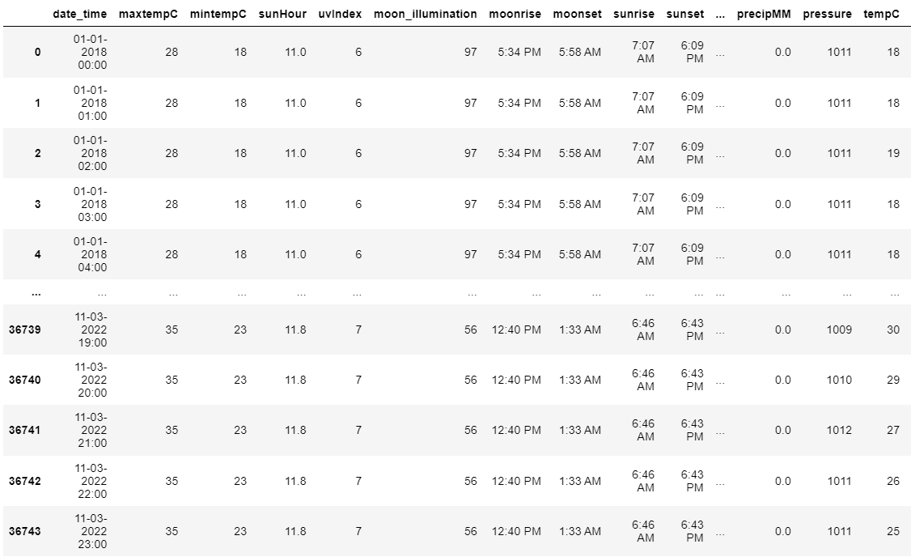
Here is short overview of Data:
Source: Kaggle.com
Link: https://www.kaggle.com/datasets/dipakdeshmukh/weather-data-of-punemaharashtraindia2008-2022
Weather Data of Pune, Maharashtra, India. (1 January 2018 to 11 March 2022).

Slide 8
Date/Time: This column typically records the date and time of the weather observation. Temperature: It includes columns such as "Temperature," which records the air temperature at the time of the observation. It have sub-columns like maximum temperature (Max Temp) and minimum temperature (Min Temp) for the day. Humidity: This column indicates the level of humidity in the air, represented as a percentage. Precipitation: Precipitation columns might include data on rainfall, snowfall, or other forms of precipitation. Common columns include "Precipitation," "Rainfall," and "Snowfall." Wind Speed: This column provides information about the speed of the wind at the time of observation, often measured in units like kilometres per hour (km/h) or meters per second (m/s). Wind Direction: It specifies the direction from which the wind is coming, usually given in degrees. Pressure: Atmospheric pressure is often included, and it can be measured in various units like millibars (mb). Visibility: Visibility refers to how far one can see in the atmosphere. It is typically measured in kilometres (km) or meters (m). Weather Conditions: This column might describe the overall weather conditions, such as "Clear," "Cloudy," "Rainy," "Snowy," etc.
Variables Name –

Slide 9
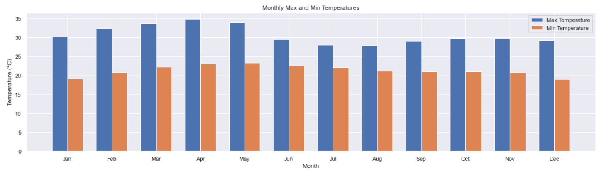
Bar Plot of Monthly Max and Min Temperatures
Exploratory Data Analysis
Conclusion:- The plot provides a visual comparison of the monthly average maximum and minimum temperatures in Pune, India, over the specified time period.

Slide 10
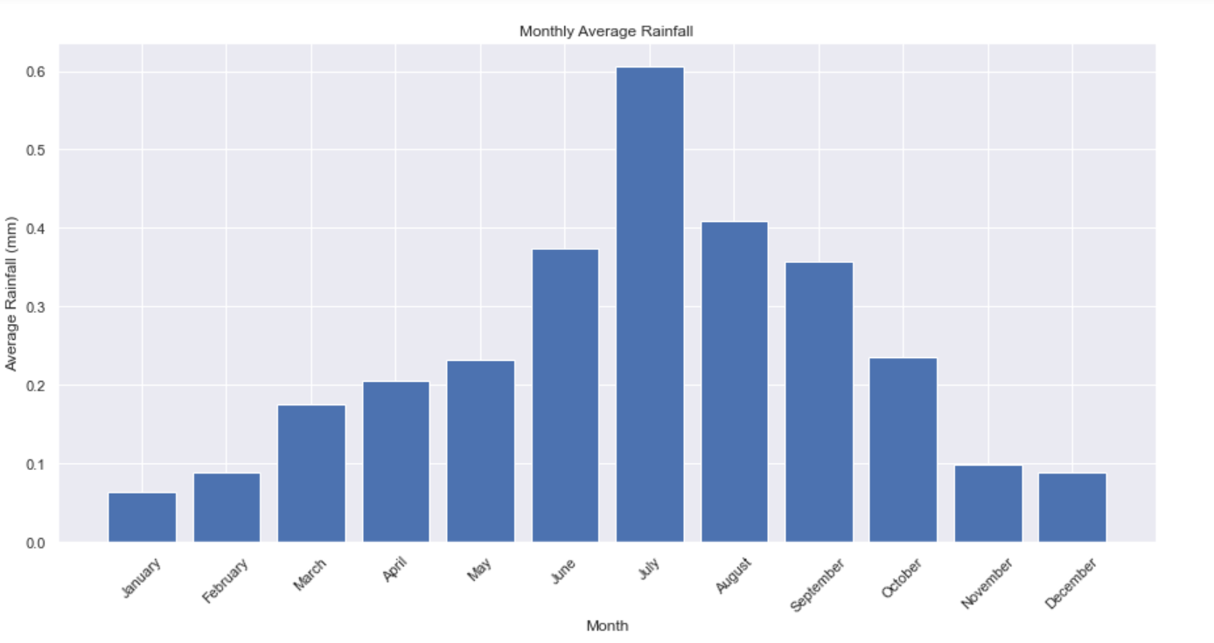
Bar Plot of Monthly Average Rainfall
Scale
0 No Rain
0.1 – 0.2 Weak Rain
0.3 – 0.4 Moderate Rain
0.5 – 0.6 Heavy Rain
>0.6 Very Heavy Rain
Conclusion:- In this plot, we can observe how the average monthly rainfall in Pune varies across the year, providing insights into the city's climate and weather patterns.

Slide 11
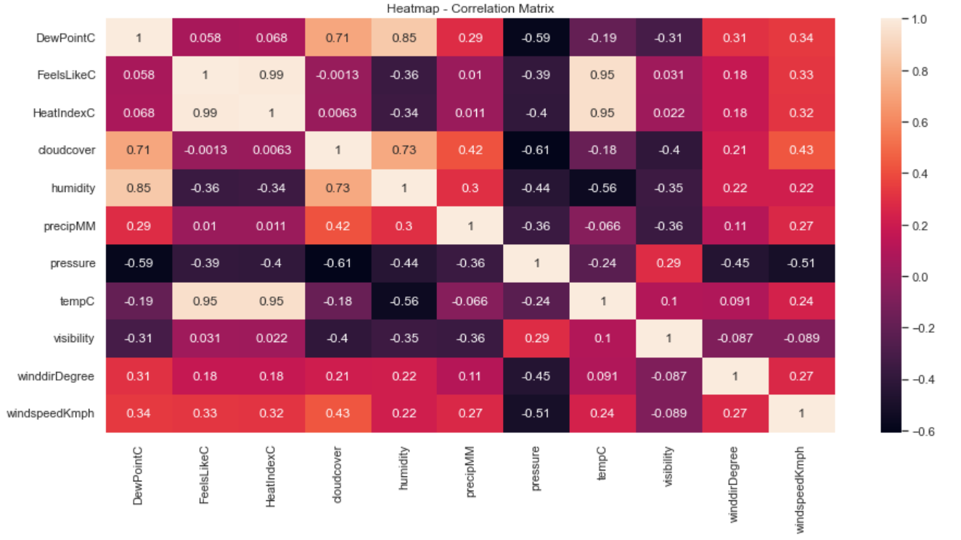
Heatmap
Conclusion:-
The heatmap of the correlation matrix provides a valuable tool for understanding the relationships between the variables in the dataset and for developing forecasting models.
FeelslikeC and Heat Index have a high positive correlation (0.99).
Pressure and Cloud cover have High negative correlation (–0.61).

Slide 12
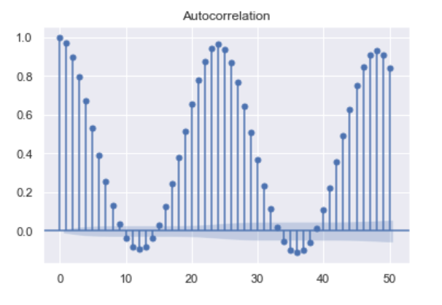
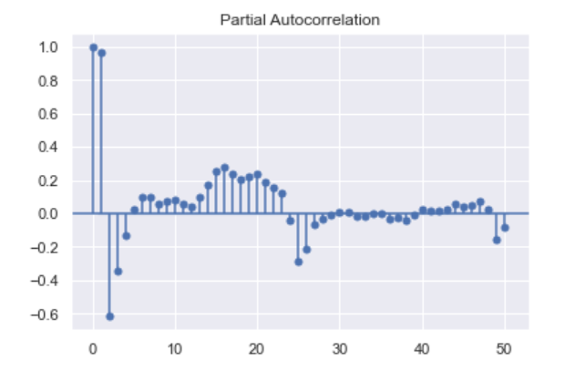
Autocorrelation Function and Partial Autocorrelation Function
Conclusion:- In the ACF plot ,we may observe seasonality.
Conclusion:- In both ACF and PACF shows significant spikes at multiple lags.
Overall, the ACF and PACF plots suggest that the temperature data can be modeled using a seasonal ARIMA model.

Slide 13
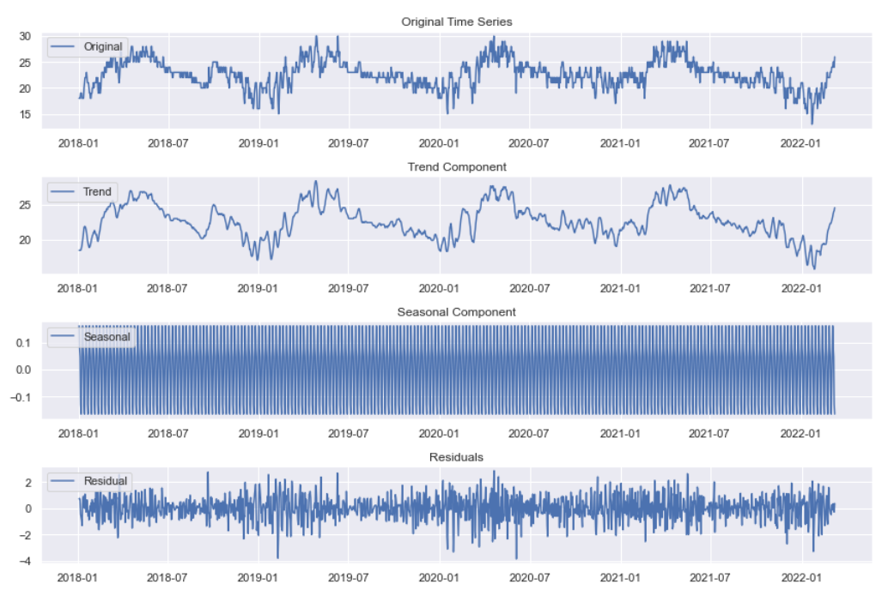
Seasonal Decomposition
Conclusion:- The trend component shows whether there is a significant long-term trend in the temperature data.
The seasonal plot shows that the temperature has a clear seasonal pattern, with higher temperatures in the summer and lower temperatures in the winter.
Residuals shows the residuals or errors after removing the trend and seasonal components.

Slide 14
SARIMA
SARIMA is a powerful tool for modelling and forecasting time series data, especially when dealing with seasonality and trend components.
Performs time series analysis on temperature data using a SARIMA model. It checks for stationarity, determines the model's orders, fits the SARIMA model to the data, and then forecasts future temperature values. The results are visualized in plots for easy interpretation.
Model:
SARIMA(p, d, q)(P, D, Q, s)
SARIMA(1,1,1)(1,1,1,24)
This formula indicates that your SARIMA model includes an autoregressive component (ARIMA) and a seasonal component (SARIMA) to capture both the short-term and long-term patterns in the temperature time series data.
y_t = ϕ_1 y_{t-1} + ϵ_t - θ_1 ϵ_{t-1} + Φ_ {24} y_{t-24} + Θ_ {24} ϵ_{t-24}

Slide 15
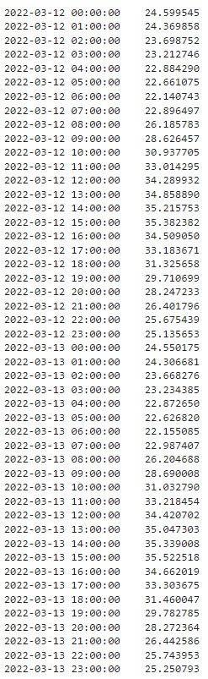
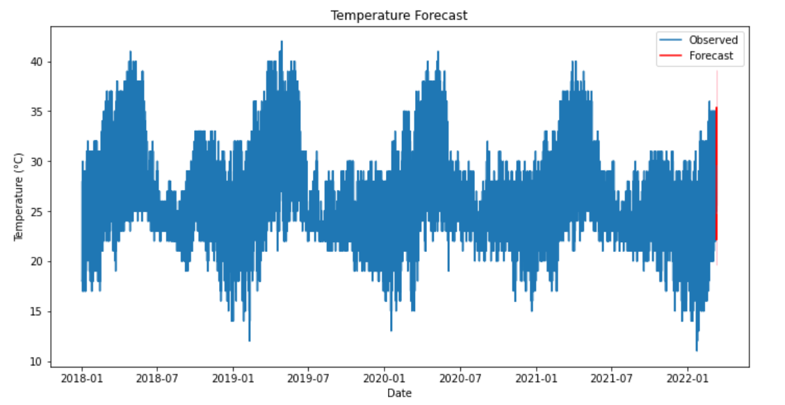
Temperature Forecasting Using SARIMA Model
Conclusion:- Using the SARIMA model we Forecast the Temperature of the next 2 days(48 Hours). SARIMAX model captures the historical temperature patterns and makes predictions into the future.

Slide 16
Exponential Smoothing
Why we use exponential smoothing:-
Exponential Smoothing is a popular time series forecasting method used to make predictions about future data points based on historical data. It is particularly well-suited for time series data with trends and seasonality.
It provides a way to make forecasts based on weighted averages of past observations, with more recent data points receiving higher weights. Exponential smoothing can be adapted to various scenarios by adjusting its components. Here's how to use exponential smoothing.
Model:-
y_t = F_t + S_t + e_t
The trend component is modeled using a simple exponential smoothing equation with smoothing parameter α=0.7786512:
F_t = 0.7786512 * y_t + (1 - 0.7786512) * F_{t-1}
The seasonal component is modeled using a seasonal exponential smoothing equation with smoothing parameter γ=5.952e−10:
S_t = 5.952e-10 * (y_t - F_t) + (1 - 5.952e-10) * S_{t-365}

Slide 17
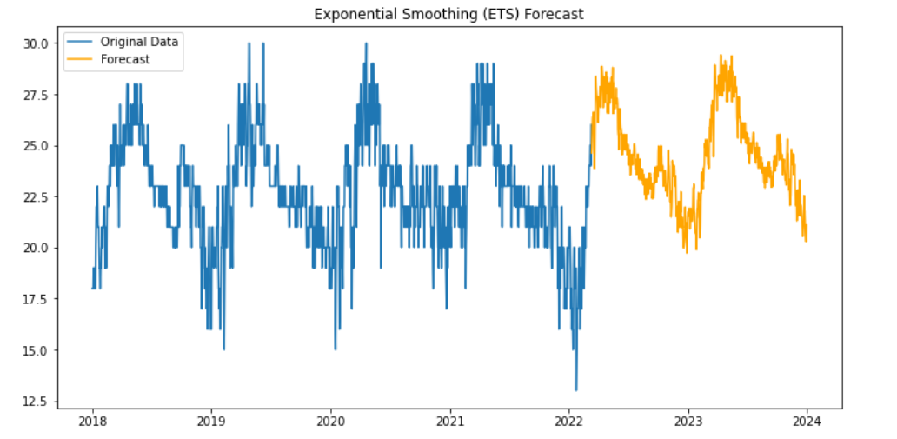
2022-03-12 | 2022-03-13
2022-03-12 00:00:00 24.216335 2022-03-12 01:00:00 23.930055 2022-03-12 02:00:00 23.145503 2022-03-12 03:00:00 22.522041 2022-03-12 04:00:00 22.374394 2022-03-12 05:00:00 21.947741 2022-03-12 06:00:00 21.058343 2022-03-12 07:00:00 21.958772 2022-03-12 08:00:00 25.659012 2022-03-12 09:00:00 28.009900 2022-03-12 10:00:00 30.459140 2022-03-12 11:00:00 32.782232 2022-03-12 12:00:00 34.045847 2022-03-12 13:00:00 34.829583 2022-03-12 14:00:00 35.460214 2022-03-12 15:00:00 35.634063 2022-03-12 16:00:00 35.044983 2022-03-12 17:00:00 34.182908 2022-03-12 18:00:00 32.427268 2022-03-12 19:00:00 30.821995 2022-03-12 20:00:00 29.154468 2022-03-12 21:00:00 26.961755 2022-03-12 22:00:00 25.822303 2022-03-12 23:00:00 25.089666 | 2022-03-13 00:00:00 24.230857 2022-03-13 01:00:00 23.944577 2022-03-13 02:00:00 23.160025 2022-03-13 03:00:00 22.536563 2022-03-13 04:00:00 22.388916 2022-03-13 05:00:00 21.962263 2022-03-13 06:00:00 21.072865 2022-03-13 07:00:00 21.973294 2022-03-13 08:00:00 25.673534 2022-03-13 09:00:00 28.024421 2022-03-13 10:00:00 30.473662 2022-03-13 11:00:00 32.796754 2022-03-13 12:00:00 34.060369 2022-03-13 13:00:00 34.844105 2022-03-13 14:00:00 35.474736 2022-03-13 15:00:00 35.648585 2022-03-13 16:00:00 35.059505 2022-03-13 17:00:00 34.197430 2022-03-13 18:00:00 32.441790 2022-03-13 19:00:00 30.836517 2022-03-13 20:00:00 29.168989 2022-03-13 21:00:00 26.976276 2022-03-13 22:00:00 25.836824 2022-03-13 23:00:00 25.104187
Temperature Forecasting Exponential Smoothing
Conclusion:- The blue line represent the original temperature data and the orange line represents the forecasted values of temperature for next 365 days (1 Year).
Using the Exponential Smoothing model, We Forecast the Temperature of the next 2 days (48 Hours).

Slide 18
Random Forest Regressor
Random forest regressor is a powerful machine learning algorithm that is widely used for regression tasks. It is an ensemble method that combines multiple decision trees to produce more accurate and robust predictions.
Random forest regressors are particularly well-suited for handling complex and nonlinear relationships between variables. They are also relatively resistant to overfitting and can handle a large number of input features.
Leo Breiman introduced Random Forest in 2001. Random Forest is registered as trademark by Leo Breiman and Adele Culter in 2006. It is a popular and it combines multiple decision trees to improve predictive accuracy and control overfitting. It is applied for both classification and regression applications for the analysis of large dataset.

Slide 19
Forecasted Values
2023-03-12 00:00:00: 25°C 2023-03-12 01:00:00: 25°C 2023-03-12 02:00:00: 25°C 2023-03-12 03:00:00: 24°C 2023-03-12 04:00:00: 23°C 2023-03-12 05:00:00: 23°C 2023-03-12 06:00:00: 24°C 2023-03-12 07:00:00: 24°C 2023-03-12 08:00:00: 24°C 2023-03-12 09:00:00: 29°C 2023-03-12 10:00:00: 30°C 2023-03-12 11:00:00: 32°C 2023-03-12 12:00:00: 33°C 2023-03-12 13:00:00: 34°C 2023-03-12 14:00:00: 34°C 2023-03-12 15:00:00: 34°C 2023-03-12 16:00:00: 34°C 2023-03-12 17:00:00: 32°C 2023-03-12 18:00:00: 31°C 2023-03-12 19:00:00: 29°C 2023-03-12 20:00:00: 28°C 2023-03-12 21:00:00: 27°C 2023-03-12 22:00:00: 26°C 2023-03-12 23:00:00: 25°C
Random Forest Regressor model
.
Model:
Random Forest Regression Equation:
tempC = 0.60 * humidity + 0.21 * windspeedKmph + 0.10 * pressure + 0.09 * precipMM + b
where:
b is the bias term or error term.
This equation suggests that temperature can be effectively predicted using a combination of humidity, windspeedKmph, and pressure. Humidity contributes the most to temperature prediction, followed by windspeedKmph and pressure. PrecipMM and have relatively minor influences on temperature prediction.
Using the Random Forest Regressor model, Forecast the temperature of the next 24 hours (1 day).
The forecasted values are given in the table.

Slide 20
Comparison performance of Time Series models and Random Forest Regressor model
Compare the performance of SARIMA model, Exponential Smoothing model and Random Forest Regressor on the basis of the AIC (Akaike Information Criterion) and the BIC (Bayes Information Criterion).
The AIC and BIC values for the SARIMA model
AIC: 65674.056
BIC: 65716.611
The AIC and BIC values for the Exponential Smoothing model
AIC: 689.845
BIC: 2757.972
The AIC and BIC values for the Random Forest Regressor
AIC: 57893.07
BIC: 58100.56
Conclusion: On AIC and BIC values of the SARIMA model, Exponential Smoothing model and Random Forest Regressor it is seen that the Exponential Smoothing model is best model for the forecasting the temperature. It is a simple and effective model that is easy to understand and implement, and it produces accurate forecasts.

Slide 21
Also Compare the performance of SARIMA model, Exponential Smoothing model and Random Forest Regressor on the basis of the MSE (Mean Square Error) and MAE (Mean Absolute Error) and RMSE (Root Mean Square Error).
The MSE, RMSE and MAE of SARIMA model
• MSE: 38.85
• RMSE: 6.23
• MAE: 5.99
The MSE, RMSE and MAE of the Exponential Smoothing model
• MSE: 5.17
• RMSE: 2.27
• MAE: 1.98
The MSE, RMSE and MAE of the Random Forest Regressor
• MSE: 9.05
• RMSE: 3.00
• MAE: 2.52
Conclusion: The Exponential Smoothing model is the best model for this data based on all three metrics (MSE, RMSE, and MAE). It is a simple and effective model that is easy to understand and implement, and it produces accurate forecasts.

Slide 22
The overall Conclusion of comparison of models:
The Random Forest Regressor model, with its ability to handle complex nonlinear relationships, produced more accurate forecasts compared to the SARIMA and Exponential Smoothing models based on AIC and BIC values. However, the Exponential Smoothing model outperformed the Random Forest Regressor in terms of MSE, RMSE, and MAE metrics.

Slide 23
Conclusion
The analysis of the weather data revealed distinct seasonal patterns and variations. The average maximum temperature reaches its highest point in April and May, while the average minimum temperature drops to its lowest point in December and January. The rainfall pattern also exhibits a seasonal trend, with the highest rainfall occurring in July and the lowest rainfall occurring in January.
The Exponential Smoothing model is the best model for this data based on all three metrics (MSE, RMSE, and MAE) and also from the comparison of the AIC and BIC values. It is a simple and effective model that is easy to understand and implement, and it produces accurate forecasts.

Slide 24


